Slide 1
CHAPTER 11
FREQUENCY-DOMAIN FILTERING

Slide 2
WHAT WILL WE LEARN?
Which mathematical tools are used to represent an image’s contents in the 2D frequency domain?
What is the Fourier transform, what are its main properties, and how is it used in the context of frequency-domain filtering?
How are image processing filters designed and implemented in the frequency domain?
What are the differences between low-pass and high-pass filters (HPFs)?
What are the differences among ideal, Butterworth, and Gaussian filters?

Slide 3
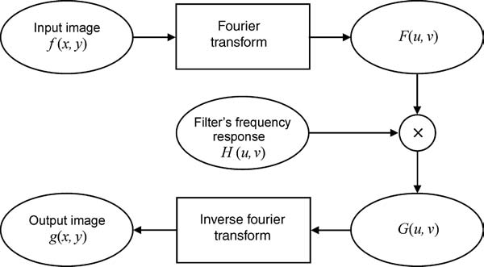
Frequency-domain operations

Slide 4
TRANSFORM
A transform is a mathematical tool that allows the conversion of a set of values to another set of values, creating, therefore, a new way of representing the same information.
Original domain spatial domain
Results domain: transform domain

Slide 5
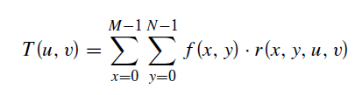
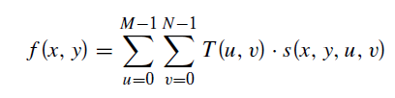
Forward and Inverse transform
Forward transform
Inverse transform

Slide 6
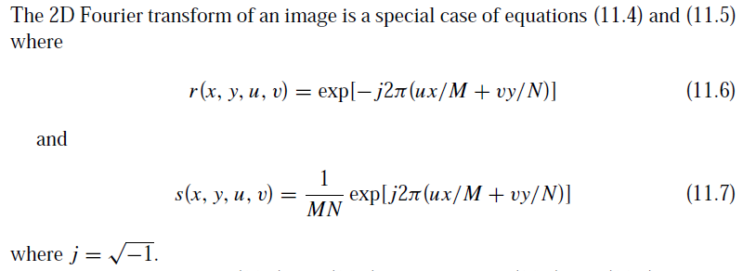
The 2D Discrete Fourier Transform

Slide 7
In MATLAB
2D FT: fft2
Inverse FT: ifft2
Example:
I = imread(’Figure11_04_a.png’);
Id = im2double(I);
ft = fft2(Id);
ft_shift = fftshift(ft);
imshow(log(1 + abs(ft_shift)), [])

Slide 8
Properties of the Fourier Transform
Linearity:
Translation:
Conjugate Symmetry: F(u, v) = F∗(−u,−v)
Periodicity: infinitely periodic in both the u and v directions
Separability: can be computed by two passes of the 1D FT algorithm
Rotation: If an image is rotated by a certain angle θ, its 2D FT will be rotated by the same angle

Slide 9
Other Mathematical Transforms

Slide 10
LOW-PASS FILTERING
Attenuate the high-frequency components and leaving the low-frequency components unchanged
Ideal LPF
Gaussian LPF
Butterworth LPF

Slide 11
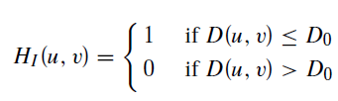

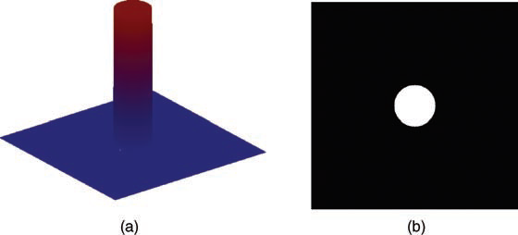
Ideal LPF
where
is distance between a point of coordinates (u, v) and the origin of the 2D frequency plan
: cutoff radius

Slide 12
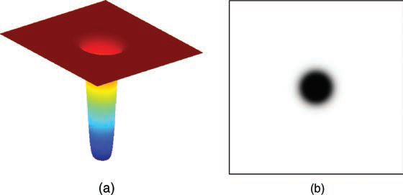
HIGH-PASS FILTERING
Attenuate the low-frequency components
Enhancing the high-frequency components

Slide 13

High-Frequency Emphasis
Preserves the low-frequency contents of the input image (while enhancing its highfrequency components) by multiplying the high-pass filter function by a constant and adding an offset to the result

Slide 14
Hands-on
TUTORIALS and PROBLEMS

